Slide 1
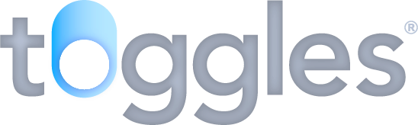
www.toggles.io

Slide 2
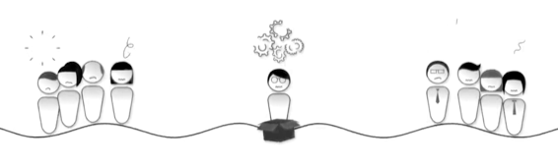
Problem
A lot changed in the software industry in the past years but releasing software to production environments is still risky and could cause ripples.
If the code doesn’t work as is hoped it could impact our customers and our companies.
Fixing release issues and rollbacks can take time and lots of resources.
In global enterprise applications we face additional problems such as rolling out new features to different countries and to different environments .

Slide 3



Solution
Enterprise Feature flags/Toggles are software development tools that take the risks and guesswork out of releasing new features to our users.
Design
Test
Build
Release
Feature off for 95% of users
Feature on for 5% of users
Code deployment is separated from releases.

Slide 4
Benefits
We can think of feature flag-driven development as a way to receive iterative market feedback on our product, rather than solely depend on isolated customer feedback. It’s a way to test how your features perform in the real world and not just in an artificial test environment.
Eliminate Release Risks
DevOps Made Faster, Easier & Safer
By deploying software in a switched-off state, you can safely and gradually reveal your code changes to targeted groups (internally or externally) before rolling out to everyone else.
By controlling the state of a feature we can eliminate feature code dependencies and achieve truly continuous delivery to deploy software more often.
Faster Growth & Returns
Cut Delivery Costs
By getting to market sooner, you are differentiating yourself from competition on a regular basis. This will leads to faster growth opportunities.
by eliminating your release risks, you no longer need to have developer on-call or waste hours of multiple people in recovery meetings.

Slide 5
Features
Gradual rollout
Approval workflow
Using feature flags rules engine we can decide to gradually rollout features to predefined segments of users or other business segments.
Enterprise feature flags come with approval workflow for any changes in production,
Instant rollback
Feature error alerts
To rollback from any release, no need to write and execute complex scripts - you simply switch the appropriate toggle off.
If a particular release registers any errors in production, you will be alerted immediately via the Toggles dashboard.
Test in production
Developer friendly SDKs
Having deployed in a switched-off state, you can then use Feature flags/Toggles to switch the release on for your testers only, for example.
Integrating Enterprise Feature flags/Toggles into your code is simple. They provide appropriate SDK for almost any programming languages.

Slide 6
Faster software development
Feature flags/Toggles enable teams of developers to all work from a single code trunk/branch.
Master
Develop
Control Release at runtime
Avoid Branches isolation
Avoid branch dependencies
Feature A
Feature B
Feature feedback

Slide 7
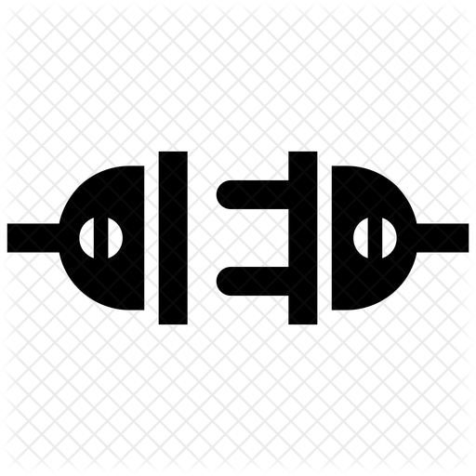
How it works
Feature Flags/Toggles APIs
Toggles SDKs
Application
Feature Flags/Toggles Dashboard
Reactive streaming
Features served in real-time
Flags management
Percentage Rollout
Rules engine
Approval Workflow
Segments management
Errors alert
Streaming
Benefits

